Slide 1
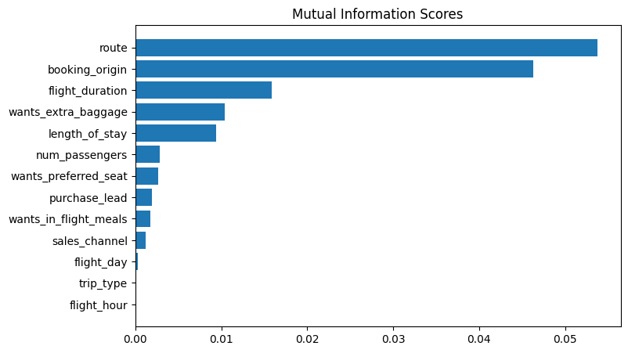
Model evaluation to understand factors influencing buying behaviour
Top 6 features are that are affecting the most in the model are ‘route’, ’booking_origin’, ‘flight_duration’, ‘wants_extra_baggage’, ‘length_of_stay’, ‘num_passengers’.
Compared 4 models:
Random forest with top 6 features
Gradient boosting with top 6 features.
Random forest with all features.
Gradient boosting with all features.
We need to optimize for AUC score, Random forest has best AUC score of 0.5614705 among above 4 models.

